Slide 1
Benefits of Kinship Care
When placed with kin, children experience more stability, less trauma, and stronger connections to family, community, and culture.
Reduced trauma and improved
child well-being
Better behavioral and mental health outcomes
Placement with kin is associated with:
Higher placement stability and improved permanency
Preservation of family, culture, and community
Source: Kinship Care is Better for Children and Families, Heidi Redlich Epstein; Factsheet: Children Thrive in Grandfamilies, Generations United
Harvard Kennedy School Government Performance Lab © 2024

Slide 2
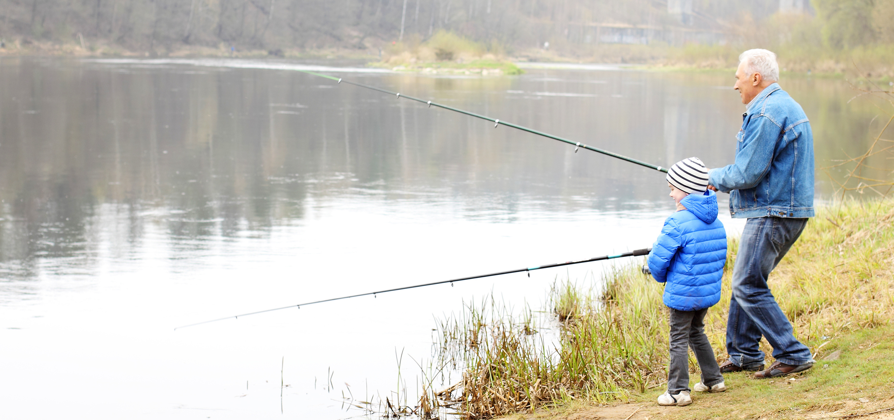
Children Feel Stronger Bonds, Greater Stability With Kin
National Studies
Local Stories
Children in kinship care were more likely to report that they always feel loved.¹
Following child adoption, relatives were more likely to report they would be willing to do it all over again.²
Non-kinship foster care has been found to have the second strongest association with placement instability after behavioral challenges.³
Example: "We moved two brothers to live with their uncle after they'd temporarily been placed in foster care. Their behavior changed soon after. I saw how their stronger bonds with a kin caregiver made them feel more secure."
Source: (1) Satisfaction of 1,100 Children in Out-of-Home Care, Primarily Foster Care, in Illinois’ Child Welfare System; (2) Kin Adopting Kin: In the Best Interest of the Children?; Never Too Old: Achieving Permanency and Sustaining Connections for Older Youth in Foster Care; (3) Foster Care Placement Instability: A Meta-Analytic Review; What Impacts Placement Stability?
Harvard Kennedy School Government Performance Lab © 2024

Slide 3
Kin Can Support Children and Their Families in Many Ways
Even when not a placement option, kin offer help during and beyond the life of a case
Placement and permanency options
Respite,
child care, and transportation help
Emotional safety and belonging
A resource to support safe visitation and reunification
Support network for child and family during and after case closure
Harvard Kennedy School Government Performance Lab © 2024
3

Slide 4
Additional Examples from [Jurisdiction name]
**Talk with case workers about successful kin placements and share those stories here. These real-life examples may help motivate and encourage other staff as they work to implement kin-first practices.
Story #1:
Story #2:
Harvard Kennedy School Government Performance Lab © 2024
4

